Slide 1

Acro Network
Submitted by :
ARUKSHA DWIVEDI - 0827IT151020
FAIZ CHOUDHARY - 0827IT151035
ADITYA SURYAWANSHI - 0827IT151008
HARSHIT PATIDAR - 0827IT151041

Slide 2
Insights
◻ Introduction
◻ Problem Statement
◻ Survey of Existing Systems
◻ Project Objectives
◻ Requirement Analysis
◻ Solution Proposed
◻ Models and Diagrams
◻ Conclusions and Limitations

Slide 3
Introduction
This Acro networking management system project document aims at defining the overall requirements for “ACRO NETWORKING”. Efforts have been made to define the requirements exhaustively and accurately. The final product will be having only features or functionalities mentioned in this Acro networking management system project document and assumptions for any additional functionality should not be made by any of the parties involved in developing / testing / implementation using the product.
In case any additional features are mandatory, formal changes / requests would be produced.

Slide 4
Problem Statement
So far there is still need of efficient acro networking website.
There is yet no any acro networking website that acro networking management system project provide efficient access and easy communication.
There is an overhead of traffic in net that acro networking management system project making chaotic situation and long time to access.
Unavailability of simplicity through which one can communicate.
In this acro networking management system project online world where everyone want to connect , so that acro networking management system project one can better coordinate with other any make work easy with enjoyment and full of joy.

Slide 5
Project Objectives
The website “ACRO NETWORK” will be used to connect the people in very easy ,simple and efficient way and one can share their feeling ,information ,ideas…..and many more…, the services offered to an individual’s choice(s) and availability for making friends among various areas and destinations. A log concerning the registration and requests for friends and various other features by users are also maintained. The website will also provide benefits to verified user(s).
The website, according to the following proposed solution, will ease the connecting people s thereby converging the world into a small system.

Slide 6
Requirement Analysis
HARDWARE INTERFACES
1-Screen resolution of at least 1024 x 760 required for proper and complete viewing of screens. Higher resolutions would not be a problem.
2-Network connection is required.
3-A minimum speed of 64kbps is required.
SOFTWARE INTERFACES
1-Any windows based operating system (Windows 98/2000/XP/VISTA/7.0).
2-SQL server 2008/2005 as the DBMS for database.
3-VISUAL STUDIO 2010/2008 for coding and designing the website.
The software mentioned in 2, 3 will only be required by the developing team for developing the website.

Slide 7
Solution Proposed
Efficient usage of resources.
It provides security through verification process.
Performance is high.
Reduces the effort and time in gathering the information about the users.
Provides a complete record of all the available vehicles for pooling.
The constraints and checks lead to a valid database.

Slide 8
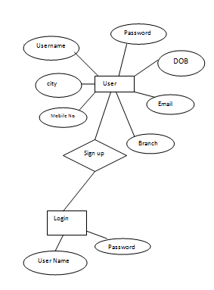
ER-MOdel

Slide 9
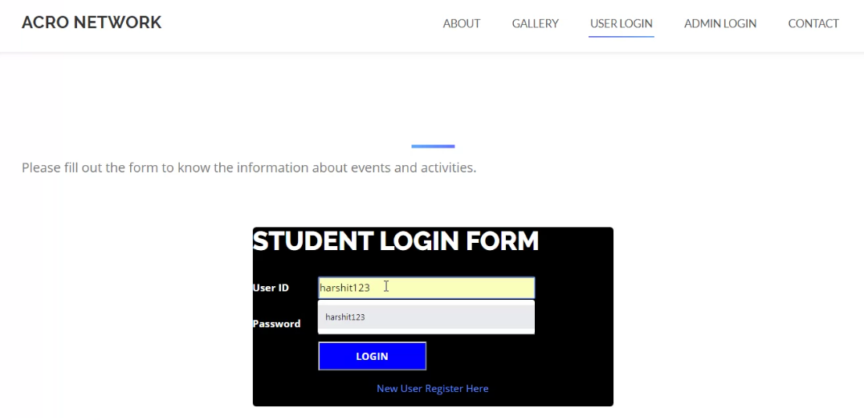
Student Login Form

Slide 10
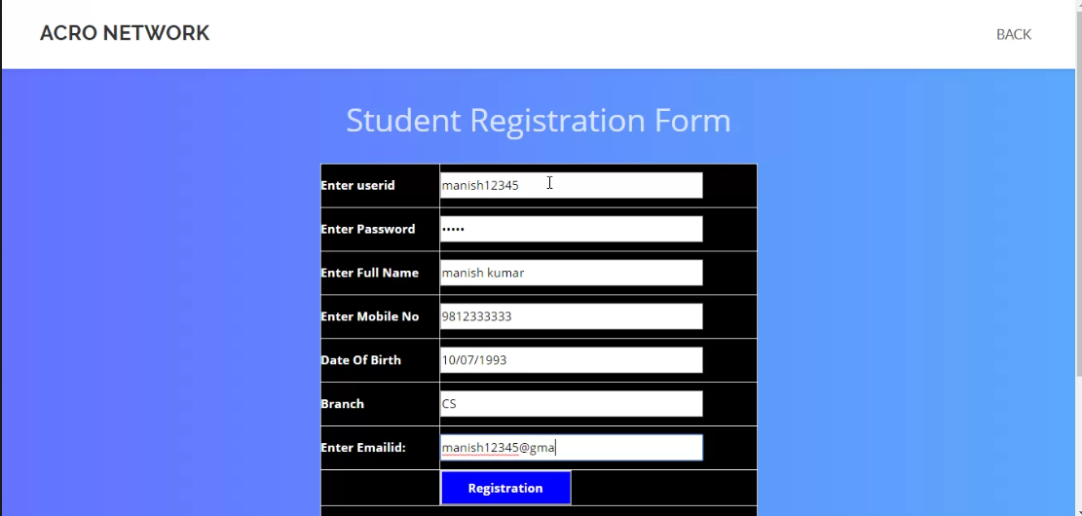
Registration Page

Slide 11
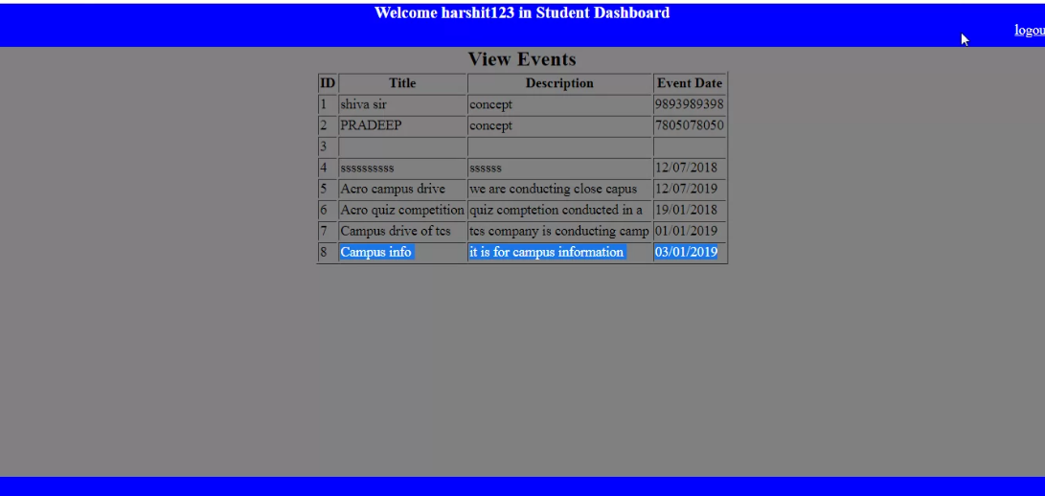
Student Dashboard

Slide 12
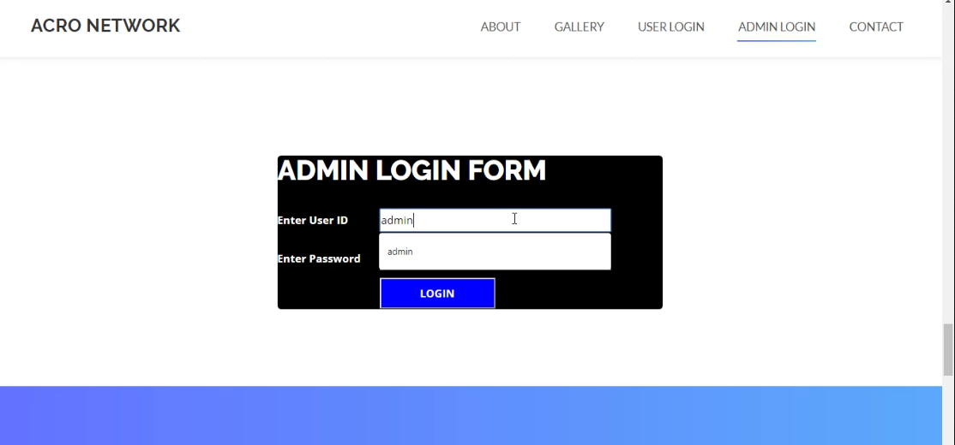
Admin Login Form

Slide 13
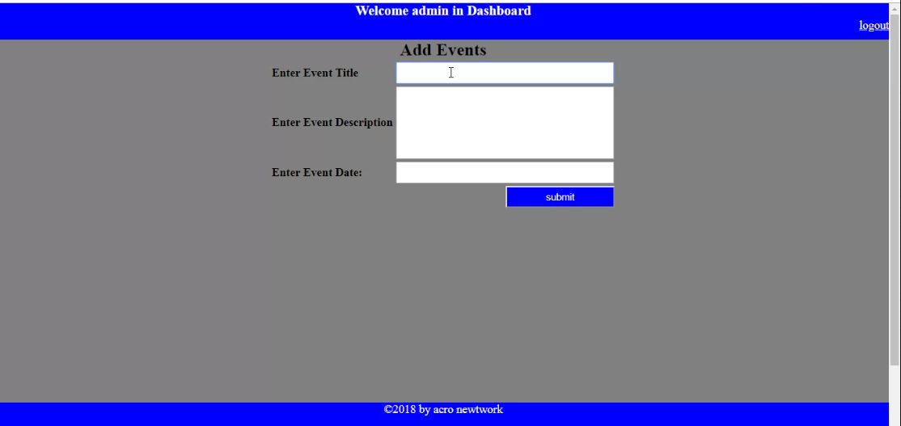
Event Post

Slide 14
Conclusions and Limitations
This acro networking management system project is designed to meet the requirements of Acro networking Site. It has been developed in ASP.NET keeping in mind the specification of the system.
For designing the system we have used simple data flow diagrams.
Overall the project teaches us the essential skills like:
Using system analysis and design techniques like data flow diagram designing the system.
Understanding the database handling.
Understanding and applying the logic required for the pooling process.

